Slide 1
PRESENTED BY:
Prudence Cele
Title: Chief Director
Budget Office
Date 11 September 2025
VULEKAMALI DATA PORTAL UPDATE
UPDATE TRANSFORMATIVE FISCAL TRANSPARENCY

Slide 2
TRANSFORMATIVE FISCAL TRANSPARENCY
  Expansion of the scope beyond departments by including Public Entities financial data Schedules 3A and 3C
  Vulekamali has successfully been transferred from external hosting
  The migration delayed updates and development on the portal
Lessons learnt
  Government ICT infrastructure/solutions are not compatible with what is available externally
  Dependency on SITA can delay efficient running of the site
  Ambition for transformative digital innovations must take into consideration succession beyond contract term with service providers
  Commitment require support beyond meetings

Slide 3
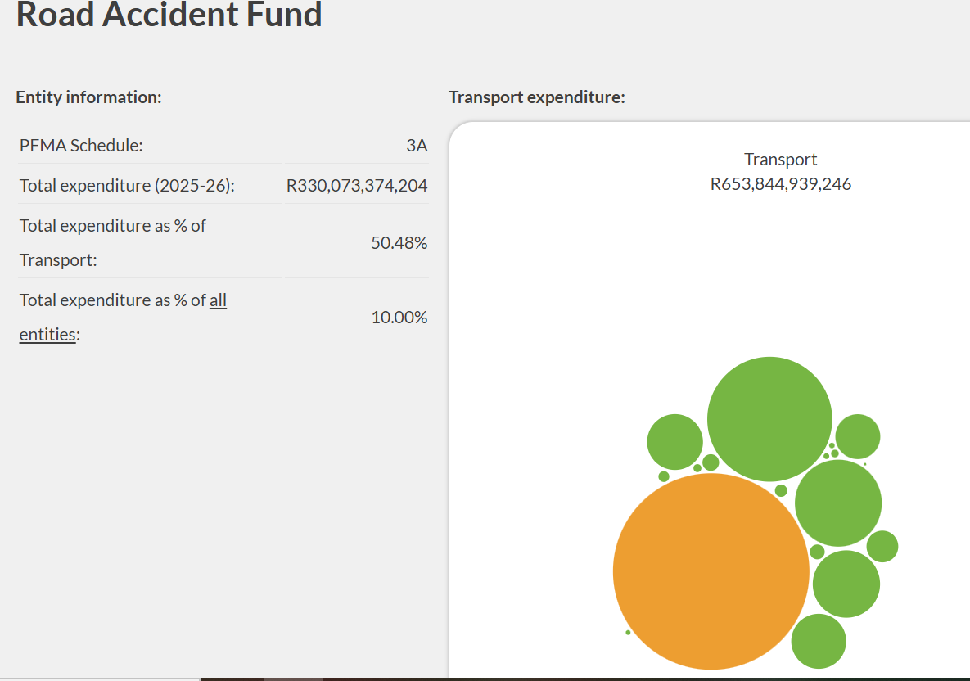
PUBLIC ENTITIES DATA
A budget literacy video will be published on the portal
National public entity data has been uploaded by schedule and on the department pages for ease of reference
Entity as a percentage of the department and size in comparison with other entities is available
The available data will be improved over time based on internal and external stakeholder requirements
https://vulekamali.gov.za/public-entities/2025-26

